Slide 1

Customer Shopping Behavior Analysis
This project analyzes customer shopping behavior using transactional data to uncover insights into spending patterns, customer segments, product preferences, and subscription behavior. Our goal is to guide strategic business decisions and optimize customer engagement.

Slide 2

Project Overview & Dataset Summary
Project Goal
Dataset at a Glance
Uncover insights into spending patterns, customer segments, product preferences, and subscription behavior to guide strategic business decisions.
3,900 Rows
Transactional data
18 Columns
Key features for analysis
Demographics
Age, Gender, Location, Subscription
Purchase Details
Item, Category, Amount, Season, Size, Color

Slide 3

Key Features & Missing Data
Comprehensive Data Points
Data Quality
Customer Demographics: Age, Gender, Location, Subscription Status
Purchase Details: Item Purchased, Category, Purchase Amount, Season, Size, Color
Shopping Behavior: Discount Applied, Promo Code Used, Previous Purchases, Frequency of Purchases, Review Rating, Shipping Type
Only 37 missing values in the Review Rating column, ensuring high data integrity for analysis.

Slide 4

Exploratory Data Analysis (EDA) with Python
01
Data Loading
Imported the dataset using pandas for efficient data handling.
02
Initial Exploration
Used df.info() for structure and .describe() for summary statistics.
03
Missing Data Handling
Imputed missing Review Rating values using the median rating per product category.
04
Column Standardization
Renamed columns to snake_case for improved readability and consistency.

Slide 5


Feature Engineering & Database Integration
Enhanced Data Features
Seamless Integration
Age Group: Created by binning customer ages for demographic analysis.
Purchase Frequency: Derived from purchase data to understand buying habits.
Data Consistency: Dropped promo_code_used after verifying redundancy with discount_applied.
Connected Python script to MySQL and loaded the cleaned DataFrame for robust SQL analysis.

Slide 6
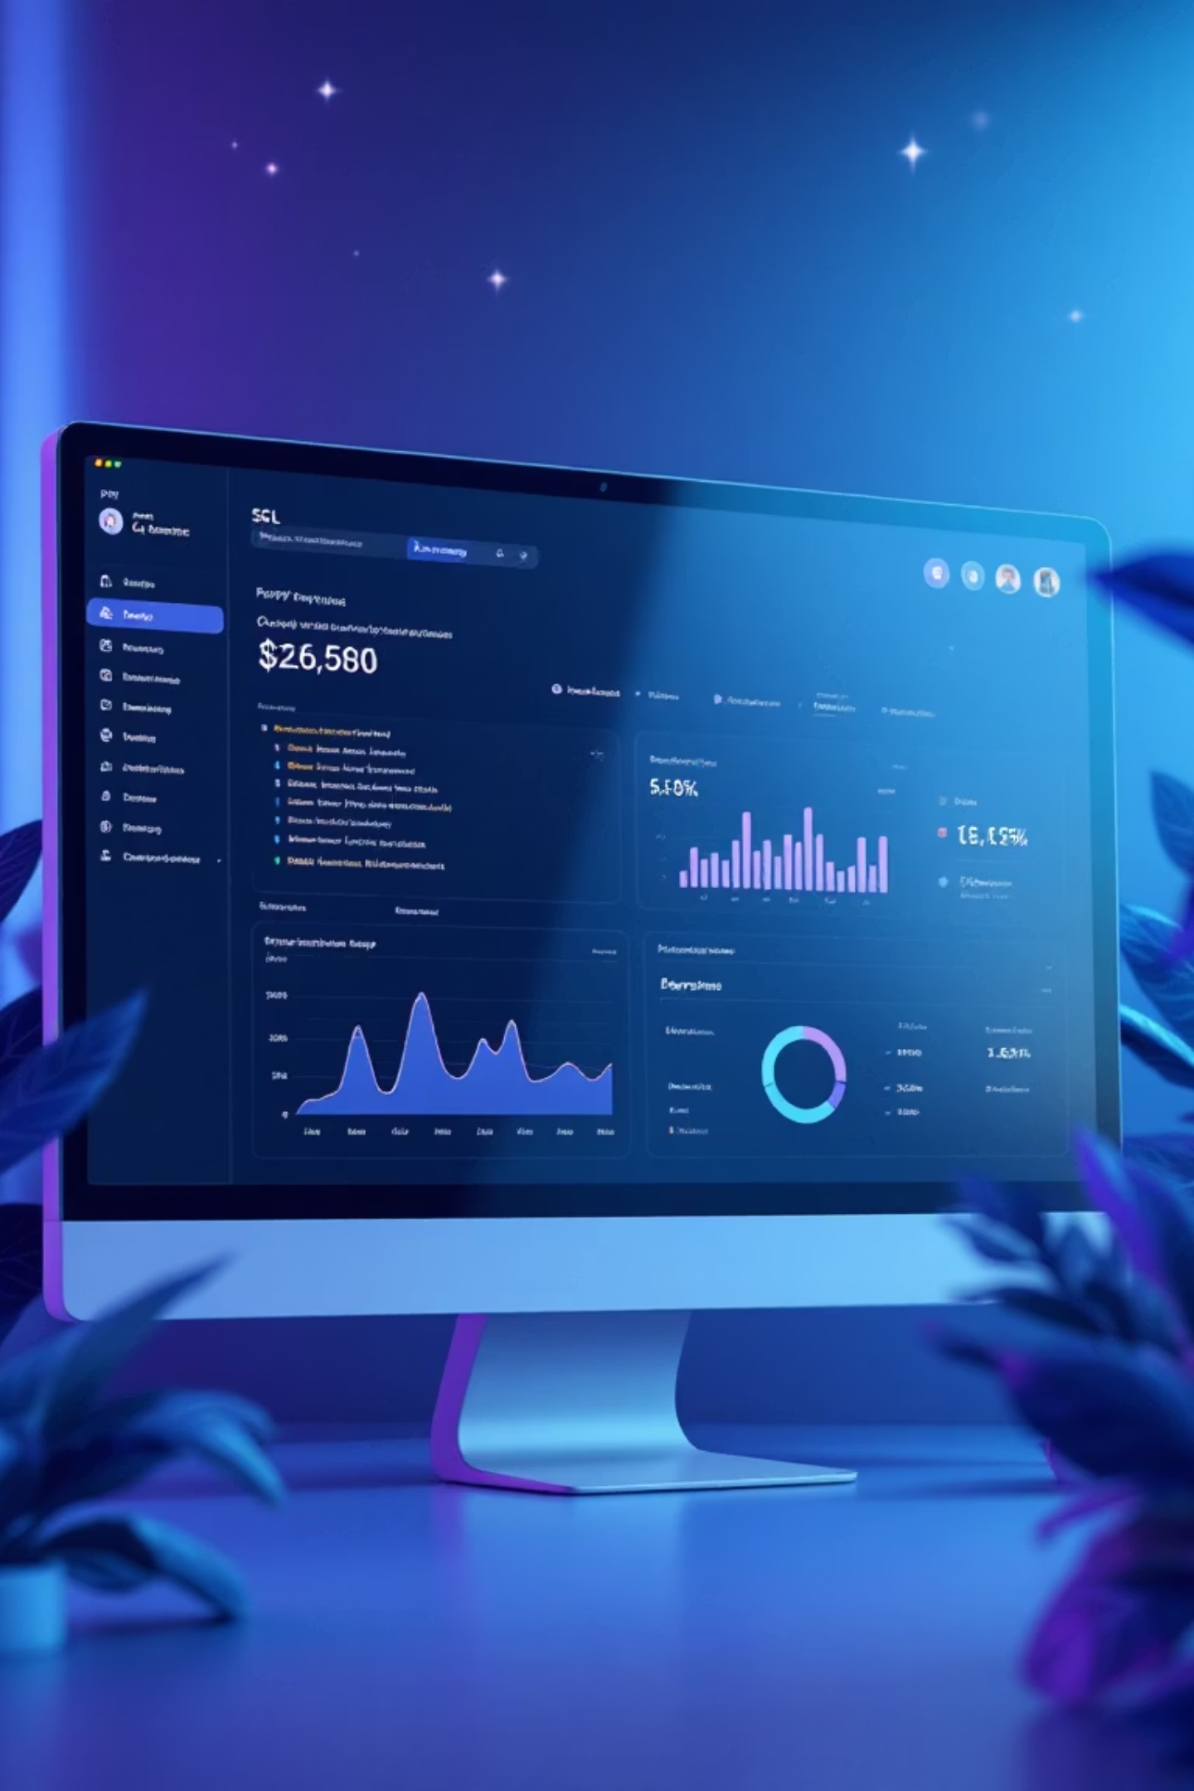
Data Analysis with SQL: Key Business Insights
1
Revenue by Gender
Male customers generated significantly more revenue ($157,890) than female customers ($75,191).
2
High-Spending Discount Users
Identified 839 customers who used discounts but still spent above the average purchase amount.
3
Top 5 Products by Rating
Gloves, Sandals, Boots, Hat, and Skirt received the highest average review ratings.
4
Shipping Type Comparison
Express shipping users had a slightly higher average purchase amount ($60.48) than Standard ($58.46).

Slide 7
SQL Insights: Subscriptions & Discounts
Subscriber vs. Non-Subscriber
Discount-Dependent Products
Yes
1053
59.49
62645
Hat
50.00
No
2847
59.87
170436
Sneakers
49.66
Non-subscribers contribute more to total revenue, but average spend is similar.
Coat
49.07
Sweater
48.17
Pants
47.37
These products show the highest percentage of discounted purchases.

Slide 8
Customer Segmentation & Product Preferences
Customer Segments
Top Products per Category
Loyal
Accessories
Jewelry
171
3,116 Customers
Clothing
Blouse
171
Footwear
Sandals
160
New
Outerwear
Jacket
163
83 Customers
Jewelry, Blouses, Sandals, and Jackets are top sellers in their respective categories.
Returning
701 Customers
Loyal customers form the largest segment, indicating strong retention.

Slide 9
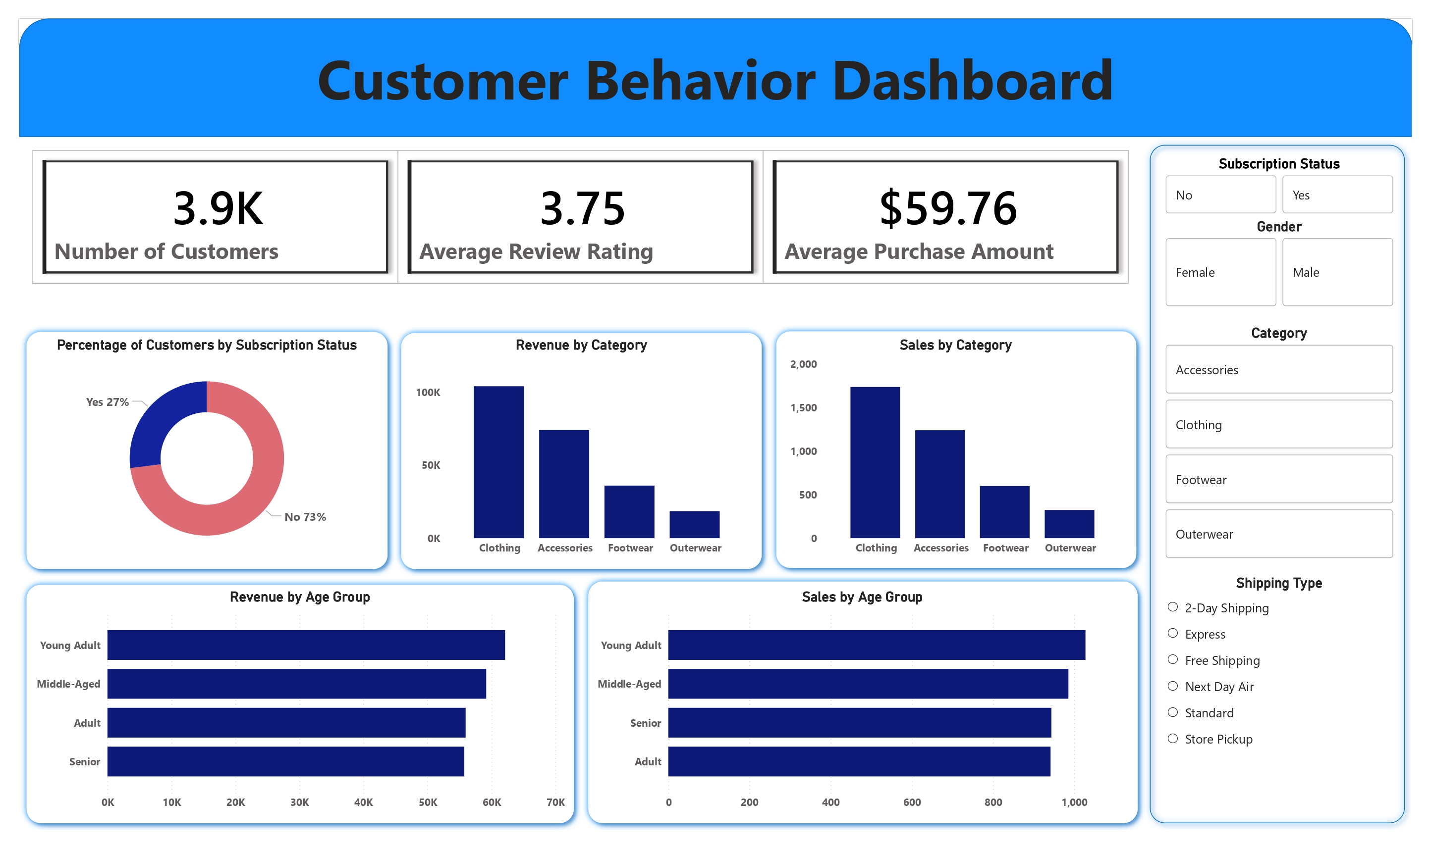
Power BI Dashboard: Visualizing Insights
Our interactive Power BI dashboard provides a clear visual representation of customer behavior.

Slide 10

Strategic Business Recommendations
Boost Subscriptions
Customer Loyalty Programs
Promote exclusive benefits to increase subscriber base.
Reward repeat buyers to foster loyalty and move them to the "Loyal" segment.
Review Discount Policy
Targeted Marketing
Balance sales boosts with margin control for sustainable growth.
Focus efforts on high-revenue age groups and express-shipping users for maximum impact.

